Slide 1
SKYPIPE
PIPELINE
A Distributed Data Processing Pipeline
Prepared by
Institution
Submission
Rugogamu Noela
Uganda Christian University
April 2026
Bachelor of Science in Data Science | Faculty of Engineering, Design and Technology

Slide 2
Executive Summary
What is SkyPipe?
Key Capabilities
A complete distributed data processing pipeline built to handle large and varied datasets efficiently. The system follows a clear three stage flow:
Multi Format Support
CSV, JSON, Excel, Parquet files via clean web interface
Distributed Storage
1
Input Stage
MinIO with full S3 compatibility for safe, scalable storage
Upload data via clean web interface
Adaptive Analytics
Apache Spark with automatic column type detection
2
Processing Stage
Layered Warehouse
Parallel analysis with Apache Spark
DuckDB with raw, processed, and analytics marts
3
Results Store Stage
Structured warehouse organization
System Qualities
Secure
Scalable
Fault Tolerant
Production Ready
Core Principles
Storage Processing Separation
Parallel Execution
Service Independence
Easy Observability

Slide 3
Project Overview & Objectives
The Problem
Core Objective
In many organisations, teams receive data files in different formats from various sources. Traditional scripts that work for only one specific file often break when the data structure changes.
Build a reliable distributed data processing pipeline with three distinct stages:
Input in Distributed Storage
Files stored safely and accessibly
Common Pain Points:
Scripts fail with format changes
Parallel Processing
Code rewriting required for each dataset
Apache Spark handles heavy computation
No unified processing approach
Organized Results Storage
Structured data warehouse with clear layers
The Solution
Specific Goals
SkyPipe creates a single, flexible pipeline that can accept many types of structured datasets and process them automatically without rewriting code each time.
1
Multi format upload
2
Distributed storage
3
Parallel processing
4
Layered warehouse
5
User authentication
6
Real time tracking

Slide 4
System Requirements
Functional Requirements
Non Functional Requirements
Multi Format Upload
Scalability
Users can upload structured datasets in CSV, JSON, Excel, and Parquet formats
System must scale to handle larger datasets without redesign
Horizontal Scaling
Cloud Ready
Automatic Validation & Storage
System validates files and stores them in distributed object storage (MinIO)
Fault Tolerance
Must continue working even if one component fails
Parallel Processing
Component Isolation
Auto Recovery
Data processed in parallel with adaptive analytics based on column types
Security
Layered Data Warehouse
Authentication and secure file access required
Results saved in structured, queryable warehouse for easy inspection
JWT Tokens
Access Control
Web Dashboard
Usability
Dashboard shows progress, summaries, and visual charts in real time
Simple and responsive interface for both technical and non technical users
Deployability
All components easy to deploy locally or in the cloud

Slide 5
System Architecture
SkyPipe uses a clean multi service architecture. Each service is independent so the system remains stable and easy to scale. The user interacts with a React web application served by Nginx, which acts as a secure gateway.
Architecture Flow
User
React Frontend
Nginx Gateway
FastAPI
Interacts with system
Web interface
Secure routing
Backend API
MinIO Storage
Apache Spark
DuckDB
S3 compatible object storage
Parallel processing
Data warehouse
Service Independence
Easy Scaling
High Stability
Each component operates autonomously
Scale components independently
Failure isolation protects system

Slide 6
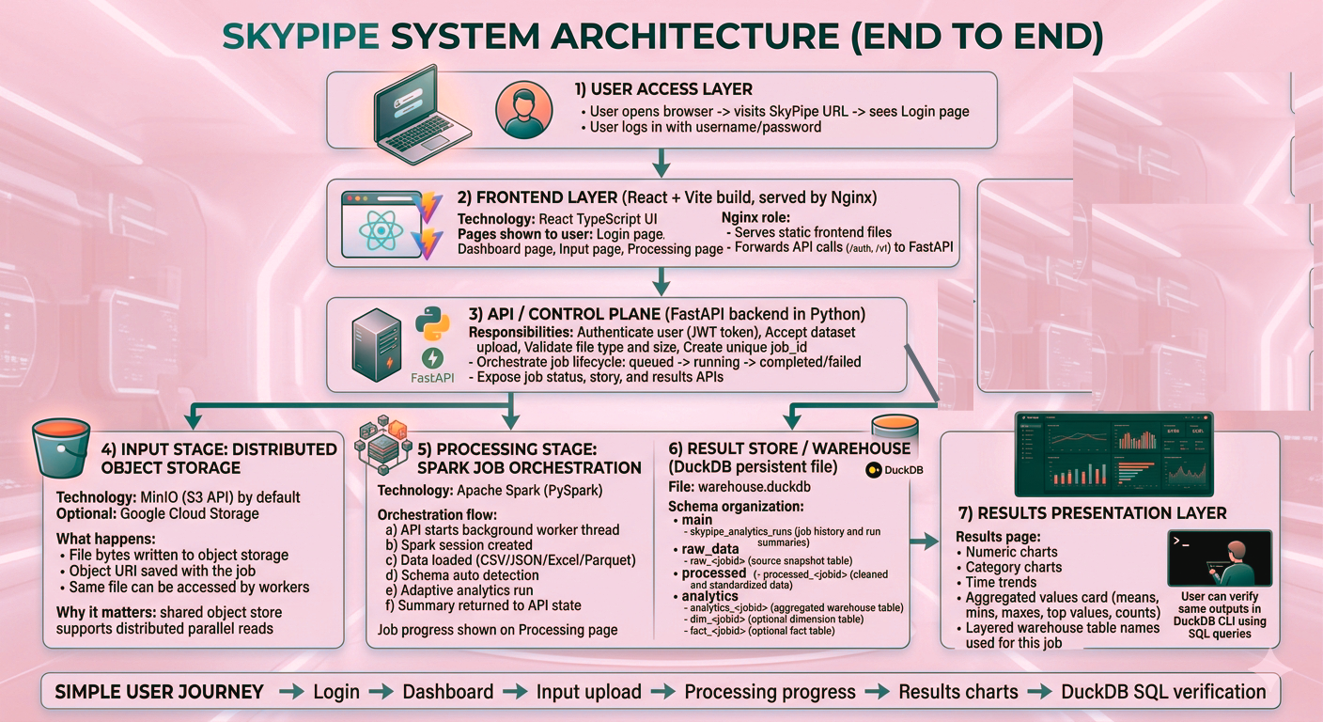

Slide 7
The Three Stage Pipeline
STAGE 1
STAGE 2
STAGE 3
Input Stage
Processing Stage
Results Stage
Upload & Store
Parallel Analytics
Layered Warehouse
Upload datasets in multiple formats (CSV, JSON, Excel, Parquet). Files are automatically validated and stored in distributed object storage.
Apache Spark with PySpark processes data in parallel, infers schema types automatically and computes adaptive statistics for your file.
Processed outputs written to DuckDB in layered schemas: raw data, processed data and analytics marts with star schema for categorical data.
Technology Stack
Automatic Detection
Three Clear Layers
MinIO with S3 API
Numeric: Mean, min, max, spread
Raw: Original data snapshots
Docker containerized storage
Categorical: Most common values
Processed: Cleaned & transformed
Cloud mode: Google Cloud Storage
DateTime: Daily & monthly trends
Analytics: Summaries & star schema
Storage is completely separate from processing, so multiple workers can access the same data safely and quickly.
This automatic approach makes the pipeline work with almost any structured dataset without custom code.
Query both raw and aggregated values through web interface or direct SQL queries.

Slide 8
Technical Implementation
Frontend Implementation
Storage Layer
Built with React and organized into four clear pages. Every screen is designed to be simple and informative so users always know what is happening.
Files are saved in MinIO using the standard S3 protocol. This provides true distributed storage that works both locally and in the cloud.
S3 API Compatible
Dashboard
Input
Distributed Storage
Three-stage overview
File upload page
Cloud Ready
Processing
Results
Live progress
Charts & summaries
Spark Analytics Layer
API & Orchestration
Apache Spark loads the uploaded file and automatically detects whether columns contain numbers, categories, dates, or boolean values.
FastAPI handles all backend operations including secure login and job management. Heavy processing runs in the background so the website stays fast and responsive.
Numeric
Categorical
JWT based authentication
Mean, min, max
Top values
Unique job ID per upload
DateTime
Boolean
Real time status updates
Trends
Distribution
Duck DB Warehouse Layer
All results stored in fast, file based DuckDB database with three clear layers. Users can view everything through web interface or query directly with SQL.
Raw Data
Processed
Analytics Marts
Star Schema

Slide 9
Asset Inventory
SkyPipe consists of several key components and processing artifacts. Each component is designed for specific responsibilities within the distributed pipeline architecture.
React Frontend
FastAPI Service
PySpark Runtime
User Interface
Backend API
Data Processing
Clean multi page web application for upload, monitoring, and results visualization. Built with modern React for responsive user experience.
Handles authentication, file uploads, and job management. Provides well documented RESTful APIs with automatic validation.
Parallel analytics engine with automatic schema detection. Processes data across multiple partitions for speed.
Nginx
MinIO
DuckDB
Web Gateway
Distributed Storage
Data Warehouse
Serves the frontend and securely routes API requests. Acts as the secure front door controlling all incoming traffic.
S3-compatible object storage for uploaded datasets. Provides true distributed storage that scales horizontally.
Persistent layered storage for raw, processed, and analytics data. Fast, file based, and SQL compatible.
Docker Compose
Makes the entire system easy to run locally or in the cloud with containerized services
Deployment Orchestration

Slide 10
Scalability & Fault Tolerance
Scalability Analysis
Fault Tolerance Mechanisms
SkyPipe is built to grow easily with increasing data volume. The architecture supports horizontal scaling at every layer.
Several features keep the system reliable and ensure data integrity even when failures occur.
Unique Job IDs
Storage Separation
Every upload gets a unique job ID that prevents conflicts between concurrent operations
Object storage separates uploads from processing so that many workers can read the same files at the same time
Clear Failure Handling
If a problem occurs, the job is clearly marked as failed and the user is notified immediately
Parallel Processing
Spark runs calculations in parallel across partitions, allowing larger files to be handled by adding more resources
Background Processing
Processing runs in the background so a single failure does not crash the website
Independent Scaling
Web, API, and storage services can each be scaled independently based on demand
Data Persistence
All final results are safely saved in DuckDB warehouse, so data is never lost
Cached Results
DuckDB warehouse avoids repeating heavy calculations for later use
Spark Retry Logic
Spark's built in retry logic handles temporary issues automatically
Container Resilience
Docker containers can be restarted individually without losing stored files

Slide 11
Security Configuration
Security is built into every layer of the system. These measures protect the system while keeping it simple to use.
Authentication
File Validation
Access Control
Users must log in with secure JWT tokens before they can upload or view data.
File uploads are checked for allowed formats and size limits to prevent misuse.
Storage access is limited to specific buckets and folders per user.
Bucket isolation
Token based auth
Format whitelist
Folder restrictions
Session management
Size restrictions
Permission based
Secure log out
Content validation
Nginx Gateway
Environment Security
Nginx acts as a secure front door, controlling all incoming requests.
Sensitive settings are stored in environment variables instead of code.
Request filtering
No hardcoded secrets
Defense in Depth
SSL/TLS encryption
Credential isolation
Multiple security layers protect the system at every level
Rate limiting
Config management

Slide 12
Technology Justification
FastAPI
DuckDB
Backend Framework
Data Warehouse
Chosen because it is fast, easy to develop with, and produces clear, well documented APIs.
Lightweight, extremely fast for analytics and stores everything in a single file that is simple to backup and inspect.
High Performance
Auto Documentation
Type Safety
Fast Analytics
Single File
SQL Compatible
Apache Spark
Nginx
Data Processing Engine
Web Gateway
Provides true parallel processing and works well with many file types , exactly what is needed for distributed data handling.
Provides a professional web gateway with SSL termination, load balancing and secure request routing.
Parallel Execution
Multi format Support
Fault Tolerance
Reverse Proxy
SSL/TLS
Load Balancing
MinIO
React
Object Storage
Frontend Framework
Gives the benefits of distributed object storage without needing a full cloud account, making the system easy to test and deploy.
Creates a smooth, modern user interface that clearly shows every stage of the pipeline with real time updates.
S3 Compatible
Self hosted
Scalable
Component based
Reactive UI
Fast Rendering

Slide 13

Conclusion & Learning Outcomes
Project Success
Learning Outcomes
SkyPipe successfully delivers a practical distributed data processing pipeline that is flexible, secure and easy to use.
The project strengthened understanding of key distributed systems concepts:
Key Achievements:
Handles full journey from file upload to warehouse storage
Distributed Storage
Parallel Processing
Remains transparent at every processing step
Object storage principles
Spark & partitioning
Production ready with security and fault tolerance
Scalable architecture for growing data needs
Service Architecture
Data Warehousing
Microservices design
Layered schemas
Challenges Solved
Long Processing Times
Ready for Real World Use
Solved by using background processing and real time progress updates to prevent website freezing
Most importantly, the project showed how good design choices make complex systems both powerful and approachable.
Warehouse Layer Creation
Ensured correct layer creation for every job through automation, careful error handling and consistent initialization scripts
Future Extensions:
Cloud Deployment
More Data Sources
ML Integration
Real time Streaming

